Slide 1
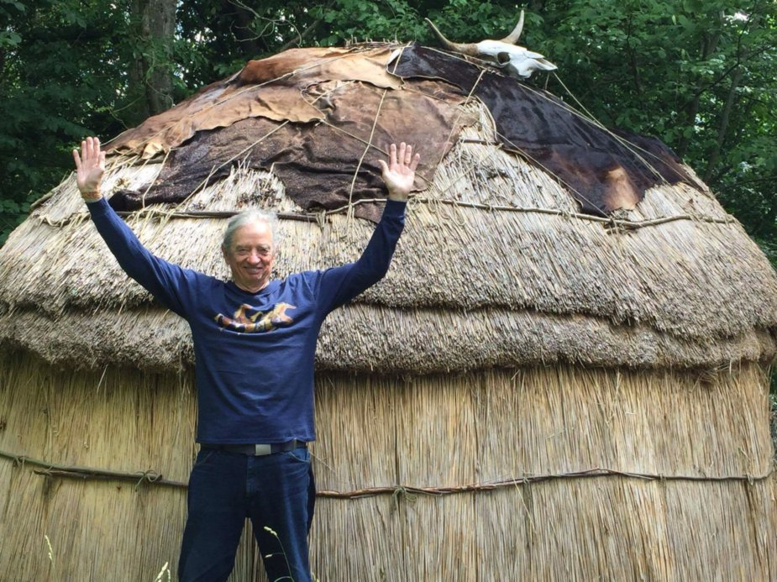
Globalization Storytelling in Liquid Modernity
David M. Boje, Ph.D.
13:30-14:15
Slides & books at http://davidboje.com/Paris
Slides & books at http://davidboje.com/Paris

Slide 2
Storytelling in relation to 3 Conference Themes
Human Resource Management (HRM) is making a turns to and away from globalization, & away from its hyper-positivism model of human=object/resource & rational actor → Living Stories is alternative
Knowledge Management is making a turn from codification/transfer to implicit-personalization of knowledge → Antenarrative is alternative
GEM&L turn to Impact of Language on Knowledge Creating, but is getting trumped by the neoliberal narrative → 4th Wave Ontologies alternative
See Martin Parker’s Guardian article & book, to bulldoze the business school

Slide 3
Liquid Modernity
Liquid Modernity = Post-Fordism + Neoliberal Globalization Progress-Narrative = Annihilation of IWOK languages, their living story webs & ‘Mother Earth’ cultural practices
Notes:
Zygmunt Bauman (2000) call is Liquid Modernity and Liquid Times (2007). His assessment is that globalization morphed from Fordism (phase III) to Post-Fordism and US Globalization (Phase IV), from stability of nation-state control to the instability, uncertainty, and disaster of Phase IV, where we are now stuck, with no way out.

Slide 4
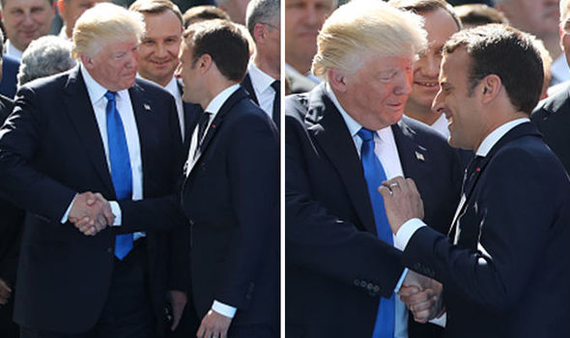
Liquid Modernity meets Neoliberalism in TRUMPLAND
Notes:
Fake Storytelling in age of Fake News or True Storytelling with ethical values. Here Trump tries his power handshake with Emmanuel Macron.

Slide 5
What is Globalization doing to End the World in your children’s children’s lifetime?
Results of focus groups so far, when asked: What was #1 Extinction threat that can bring about end of the world?
Donald J. Trump
Climate Change
Nuclear War
Pandemic
Introduction of Exotic Species
Deforestation/Habitat Loss
Pollution
Non-human causes →Asteroid, Alien Invasion, etc.
Extinction Event: causes drastic change in # of species in short period of geologic time

Slide 6
Who Will Inherit the Earth?
Cockroaches are only sustainable species in liquid modernity’s combination of post-Fordism and the instability of globalization predatory growthmania scale, greed of 1% billionaires to have all the economic-wealth, and gluttony of consumer culture for more and more, mostly useless, stuff, resulting in 6th Extinction.

Slide 7
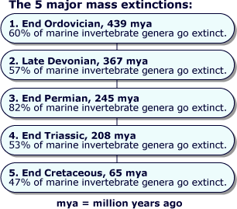

Slide 8
What is 6th Extinction
Sixth Mass Extinction is a massive die-off of plants and animals all across the planet.
Also known as Holocene extinction (mostly caused by HUMANS) or Anthropocene extinction (abrupt enough HUMAN CAUSED EXTINCTION, to be its own epoch)
If current rate of human disruption of BIOSPHERE continues then ½ of Earth higher life forms will be extinct by 2100.
6th Extinction is 10 to 100 times greater than any previous mass extinction

Slide 9
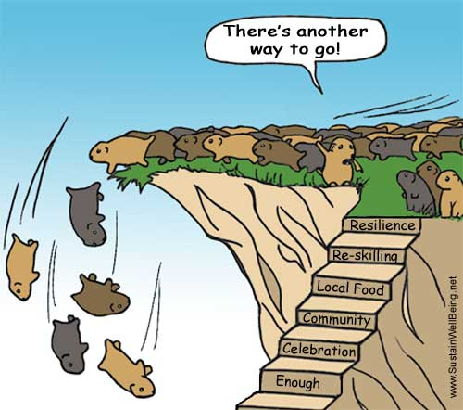
Myth: Globalization has no alternative

Slide 10
Purchasing-Power-Parity PPP
Based on narrative of a $50 Food basket for family of 4 in USA vs. $1.90 for one in any least developed nation.
World Bank’s narrative→ life of the poor is improving with globalization; world has met and surpassed 1st Millennium Development Goal—to cut the 1990 poverty rate in half by 2015, moving 1.1 billion people out of extreme poverty, five years ahead of schedule, in 2010. Thre is a Counternarrative!
World Bank narrative makes it look like Adam Smith ‘invisible hand’ global capitalism is providing poor with drinkable water, affordable housing, food, and health for all
Notes:
World Bank accessed Feb 21 2018 at https://data.worldbank.org/indicator/SI.POV.DDAY
World Bank Oct 2 2016, accessed Feb 21 2018 at http://www.worldbank.org/en/topic/poverty/overview

Slide 11
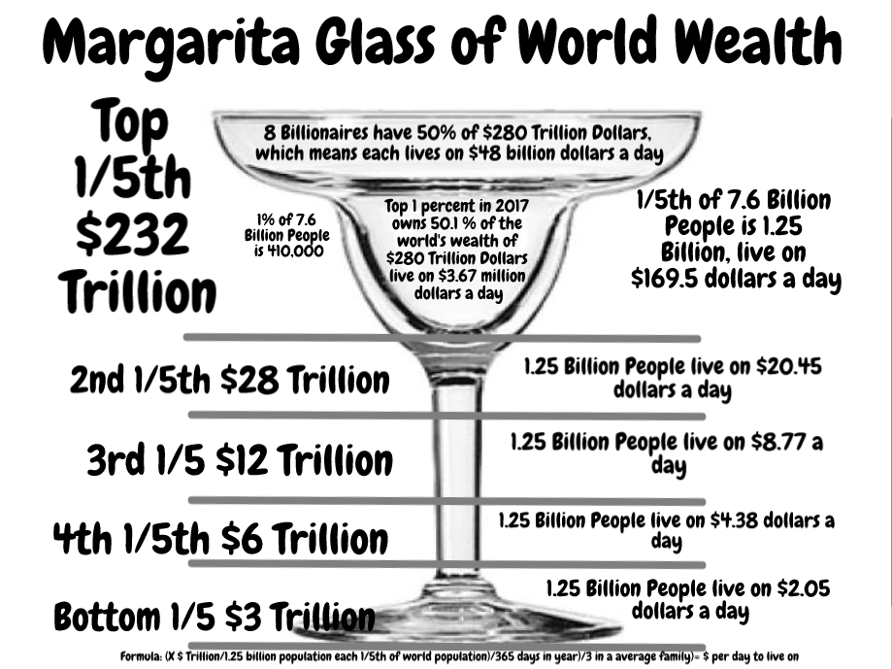
Boje’s Counternarrative to Neoliberal Price Parity Narrative

Slide 12
Liquid Modernity & Globalization Storytelling
I want to find out if IWOK can challenge, then partner with WWOK (UN Sustainability Goals) in some new way of taming neoconservative and neoliberal managerialist globalization that has led us into liquid modernity.

Slide 13
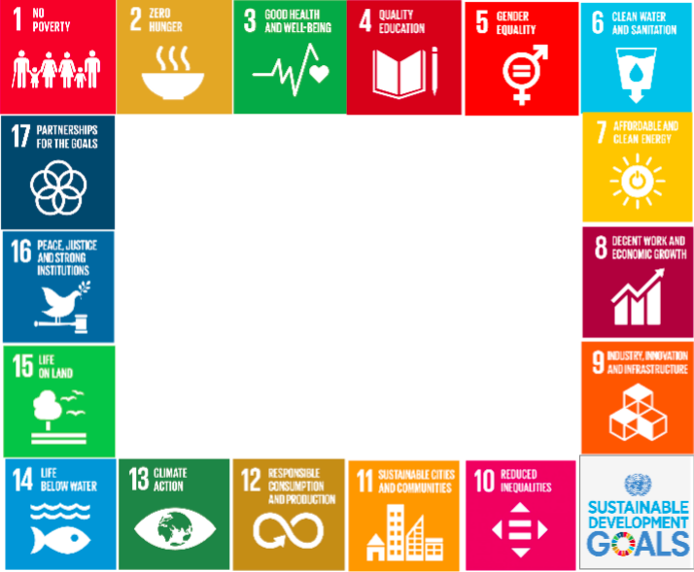
What is TRUE STORYTELLING now?
How to plan FUTURE?
When & Where to do PROJECT?
Reflect on OUTCOMES?

Slide 14
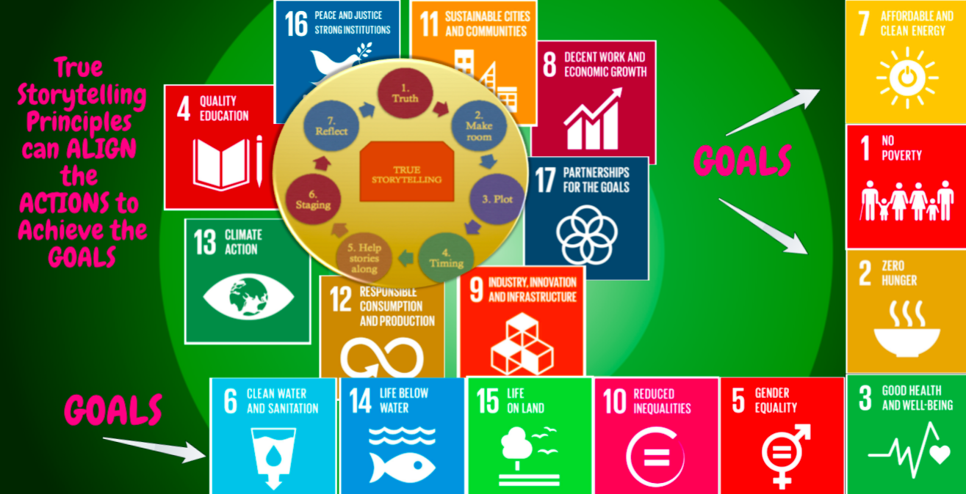

Slide 15
Bi-Lingual New Zealand
Māori managers integrate Māori (language) and Pākehā (Western, English-language) values and methods to produce results that matter to them.

Slide 16
Māori 5 Management Principles NOT US/English Schermerhorn Management book promoting Globalization Progress Narrative
Rangatiratanga (self-determination),
Whānaungatanga (relationships),
Kaitiakitanga (stewardship),
Manaakitanga (generosity),
Wairuatanga (spirituality), &
Pursuit of multiple objectives—social, cultural, economic and environmental—as indicators of progress and outcomes.
Notes:
Māori Management (Mika & O’Sullivan) in press.

Slide 17
Multi-language project: Compared 5 University of Canterbury English definitions with deeper actual Māori definitions & Added missing Kaupapa Māori Method:
Kaitiakitanga – guardianship and protection of people, environment, knowledge, culture, language and resources for future generations.
Mahinga Kai – traditional customary food gathering, encompasses the places where natural resources were obtained; the resources themselves; and the practises and principles that guided how those resources were managed
Manaakitanga –The extension of charity, hospitality, reciprocity and respect to others.
Mana Whenua – Mana or ‘authority’ held by the local hapū or iwi over the land or particular area.
Mauri Tū – environmental health is protected, maintained and/or enhanced
Kaupapa Māori – theory & methodology in plan of actions, ways of doing things, expressing “deeper worldview” (Ahukaramū & Royal, 2017: 112).

Slide 18
One Example: # 3 Manaakitanga
Manaakitanga is a time-honored practice and many early European settlers experienced Māori hospitality on their arrival in New Zealand. It’s the basis of tourism industry.
However, Manaakitanga: Is generosity killing Māori enterprises (Mika, 2014). So is use of US (English) management texts: within Planing Leading Organization & Control (PLOC) managerial functionalism narrative of Globalization ideology?
Manaakitanga is alternative to US (Schermerhorn or Robbins [globalization] management texts). Instead the Māori management, “systematic action-oriented deployment of resources by managers of Māori descent and within a Māori world view (āronga Māori), to achieve purposes which are meaningful and of benefit to whānau (family), hapū (sub-tribe), iwi (tribe) and Māori communities, in terms of both the means and ends, and which may be conducted within both Māori and non-Māori organisational contexts” (Mika and O’Sullivan, 2014: 8)
Notes:
Mika, J. P., & O'Sullivan, J. G. (2014). A Māori approach to management: Contrasting traditional and modern Māori management practices in Aotearoa New Zealand. Journal of Management & Organization, 20(5), 648-670.
Mātauranga Māori can be defined as 'the knowledge, comprehension, or understanding of everything visible and invisible existing in the universe’

Slide 19
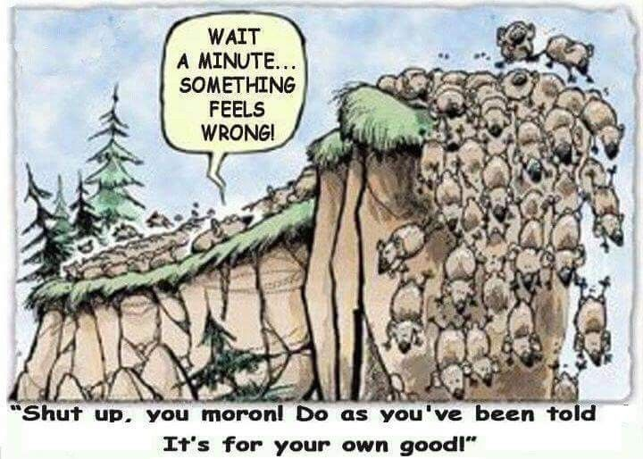
Are you tired of all the ‘Fake Storytelling’?

Slide 20
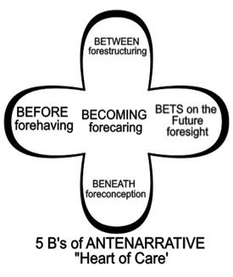
What is Antenarrative?

Slide 21
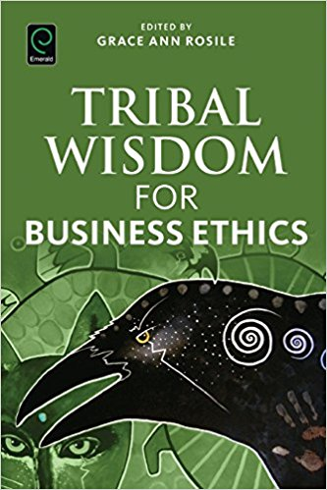
IWOK – Indigenous Ways of Knowing in Living Story Webs of Relations to Community & Earth Kaua e takahia te mana o te tangata Nga Huia Te Awe Kotuku – Don’t trample on the integrity of the people -- cited in Tuhiwai Smith 1999: 120

Slide 22
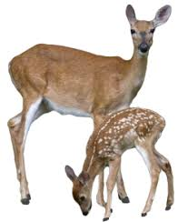
What is Living Story Web?
“Grandpa John told me endless stories about young men who had opportunities to live up to their names. One day, he said, ‘there was a young man named Looks Twice---really, he was more like a boy---who left his village alone to hunt, hoping to bring back some meat. He wanted to prove that he was a man. It was in the springtime. He went without a bow or a lance, and he killed a deer with his knife.’… ‘How did he kill the deer, Grandpa?’ I interrupted. ‘You’d better figure that out,’ he said. ‘That’s what will make you a man.’” (Russell Means, in Fixico, p. 88, as cited in Rosile, 2016: 239).

Slide 23
Living Story & Lived Context
CONTEXT: What does ‘runs like a deer’ mean?
1. How could LOOKS TWICE get close enough to kill a deer, if he is alone?
2. What kind of deer would be that slow?
3. In Spring, the rains flood the streams?
4. If one hunts with others, then there are more pairs of eyes to see
5. When something seems too good to be true…
6. If true, then is this INDIVIDUALISM the ways of TRIBAL COMMUNITY?
7. What are the sustainability long-term effects of this kind of hunting?
8. Many reasons why hunting alone is TABOO, a rule this young hunter broke
9. When growing up others hear this story and by the time they are young adult, they know the CONTEXT of the living story lessons

Slide 24
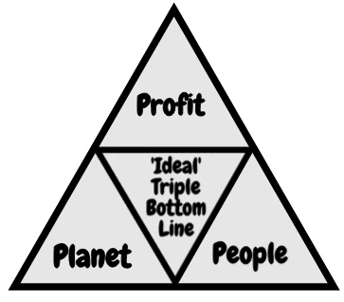
Triple Bottom Line NARRATIVE
Notes:
'Wealth: Having it all and wanting more'
Published 19 January 2015
Author: Deborah Hardoon, Senior Researcher, Oxfam GB
There were two main external data sources used:
1 - Credit Suisse Global Wealth Databook 2014
https://www.credit-suisse.com/uk/en/news-and-expertise/research/credit-suisse-research-institute/publications.html
Data was extrcated from the 2014 report and a STATA file which included revised calculations for global wealth and wealth shares dating back to 2000.
All data from Credit Suisse is highlighted in blue in this file

Slide 25
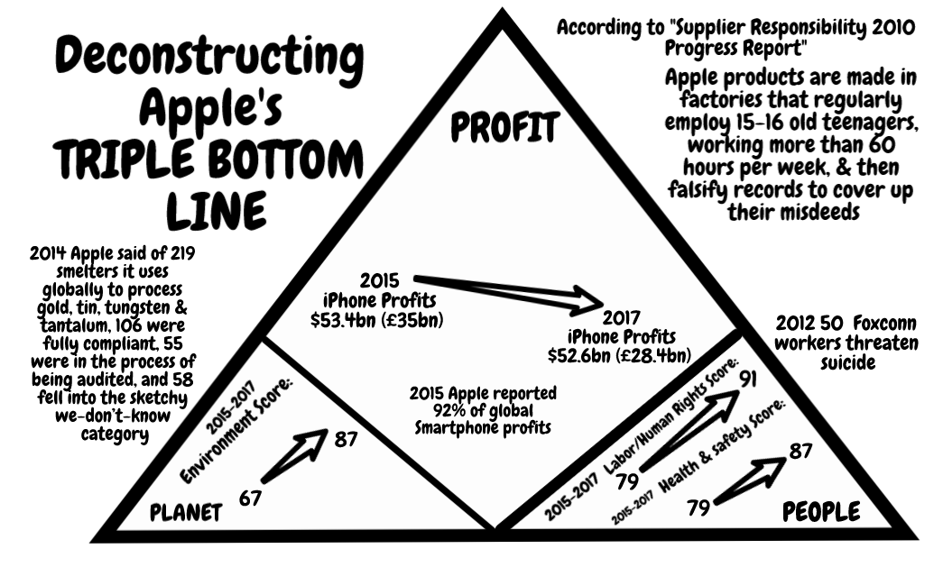
Deconstructing Apple’s CSR Report

Slide 26
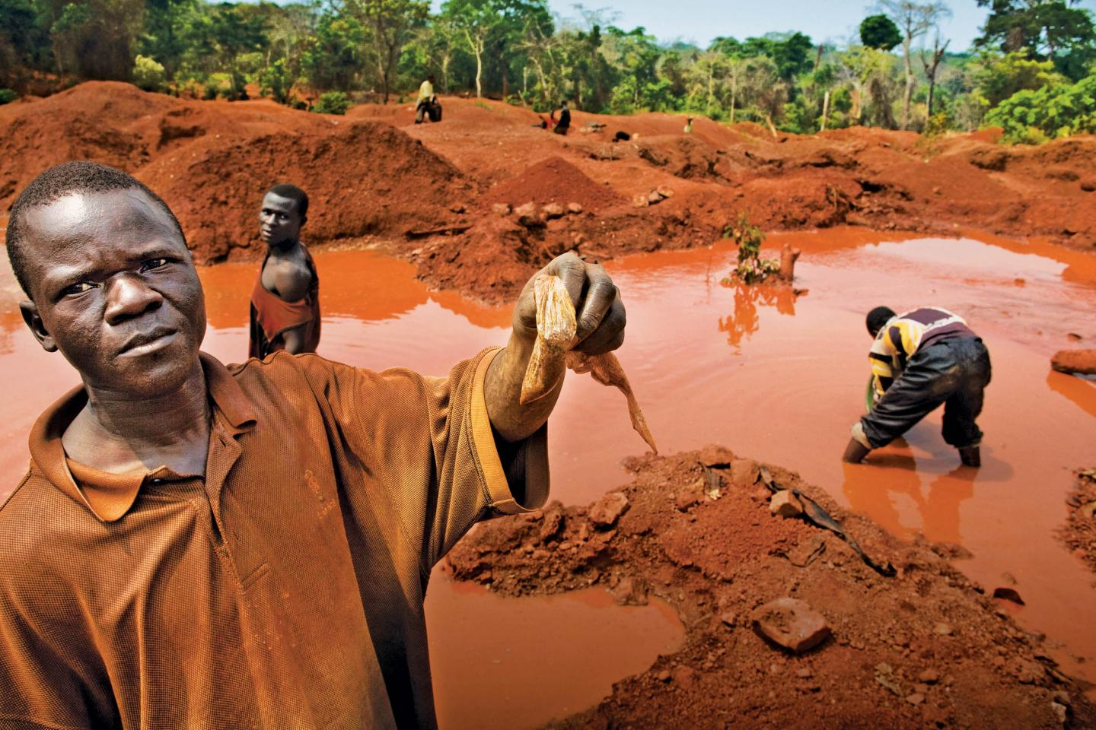
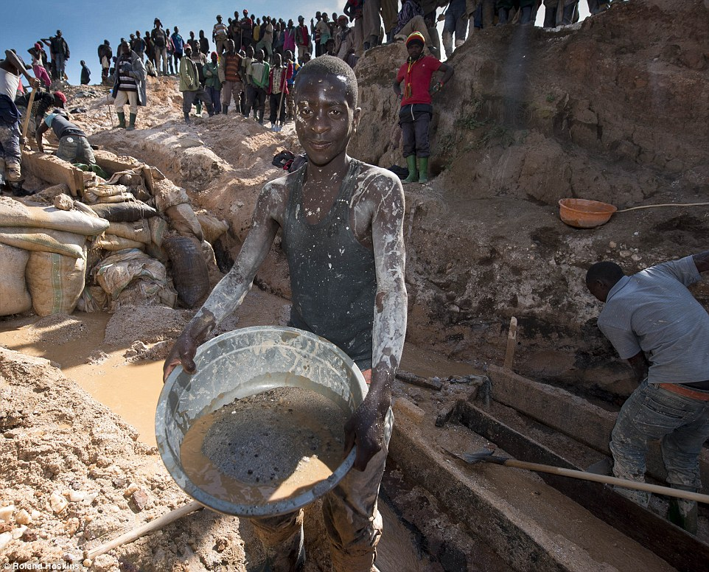
Democratic Republic on of Congo (DRC) HIDDEN COSTS Counternarrative
Notes:
2nd picture http://www.dailymail.co.uk/news/article-3280872/iPhone-mineral-miners-Africa-use-bare-hands-coltan.html

Slide 27
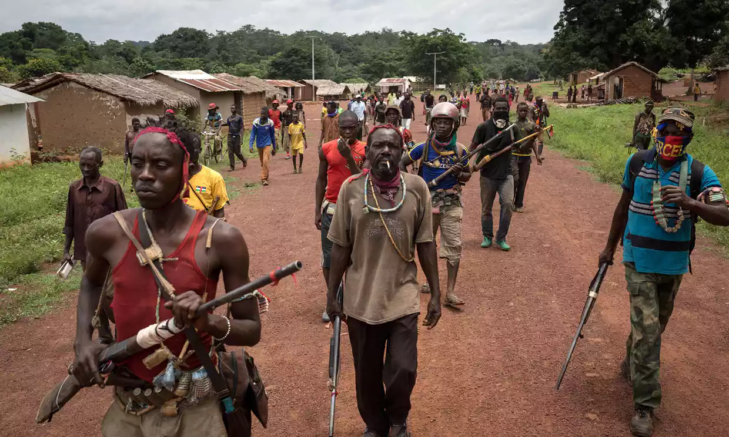
Hidden Costs of Globalization
Notes:
Looting, escalating violence, and more death by rival rebel groups in CAR, as aid organizations withdrew at height of malaria season. One result is women are denied a safe place to give birth. Armed rebels entered a hospital where 7,000 sought refuge, and killed a baby held by its mother. 6 Red Cross volunteers were hilled in an attack on a health center. Health workers have to negotiate with armed people to gain access to villages. Stephen O’Brien a UN emergency relief coordinator, said this is “the early warnings of genocide”.
'People are dying': violence forces aid workers out of Central African Republic, by Rebecca Ratcliffe
Fri 1 Sep 2017 06.04 EDT
Last modified on Mon 11 Dec 2017, accessed Feb 16 2018 at https://www.theguardian.com/global-development/2017/sep/01/people-are-dying-violence-forces-aid-workers-out-of-central-african-republic

Slide 28
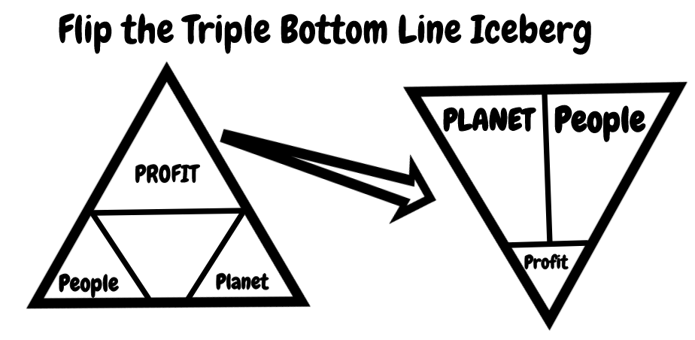

Slide 29
Critique of Triple Bottom Line
3BL assumes 3 bottom lines are EQUAL
Measures exist for PROFIT; disagreement on or missing ‘real’ measures of PLANET and PEOPLE
3BL = Greenwashing narrative used to make it seem like Corporate Sustainability exists
3BL = narrative exceptionalism→ humanity creates itself as outside the natural limits of ecosystems AND technology can solve any problem
3BL = humancentric narrative opposed by the counternarrative of posthumanism (all species matter)

Slide 30
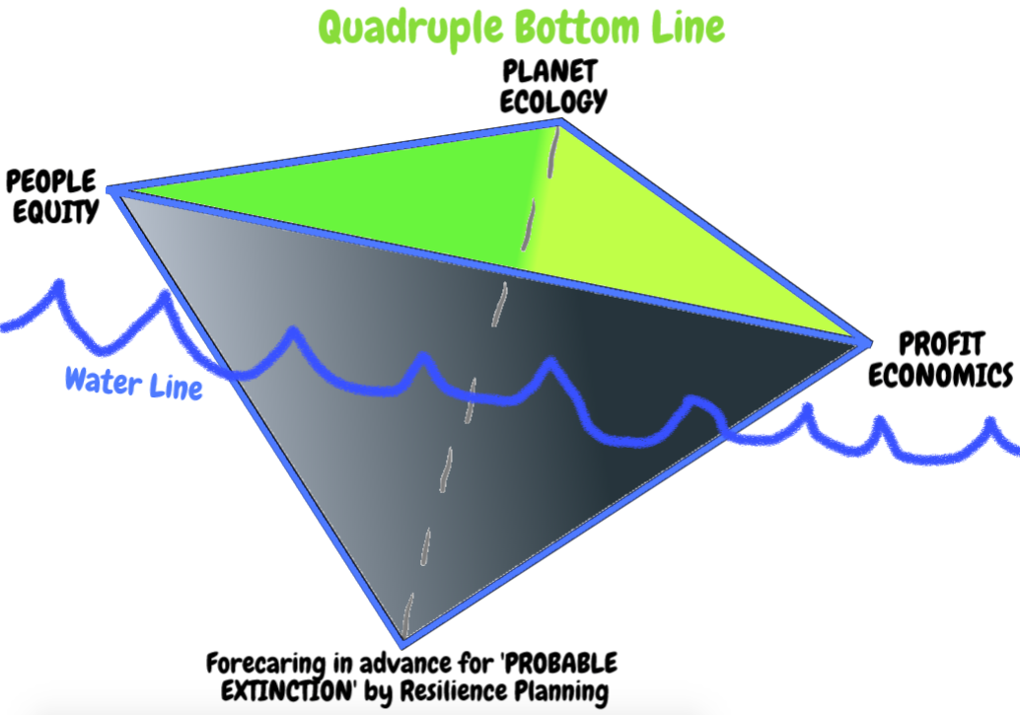
4BL of MOTHER EARTH ECONOMY

Slide 31
Cell-phone’s 3T’s + Gold
CONFLICT MINERALS
Tin is used as a solder on laptop and cellphone circuit boards
Tungsten makes your cellphone vibrate
Tantalum stores electricity on your cellphone
Gold is used to coat the cellphone wiring

Slide 32
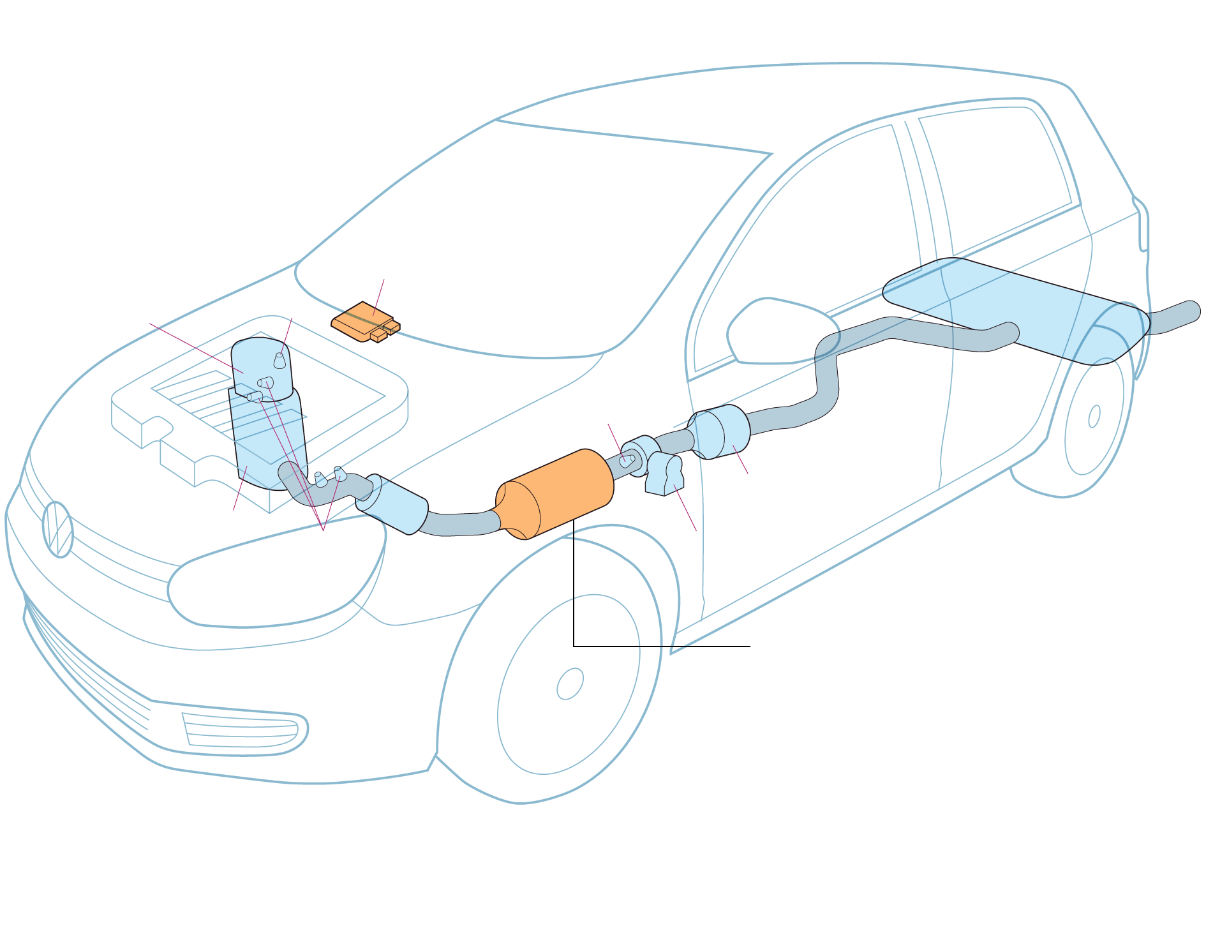
MATERIAL STORYTELLING → DIESELGATE
Main computer
Engine control module senses when car in LAB TEST because steering wheel does not move
Muffler
Diesel oxidation
catalytic converter
& Oxygen Sensor
H2S Catalytic Convert
Nitrogen oxide trap - Reduces toxic emissions. Engine used more fuel when trap engaged. Computer saves fuel by allowing more pollutants to pass through exhaust
Temperature Sensors

Slide 33
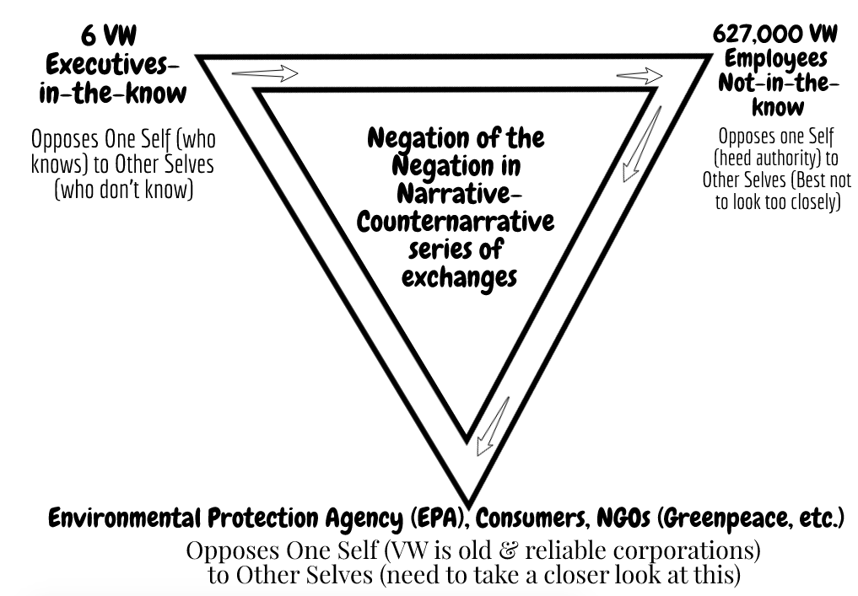

Slide 34
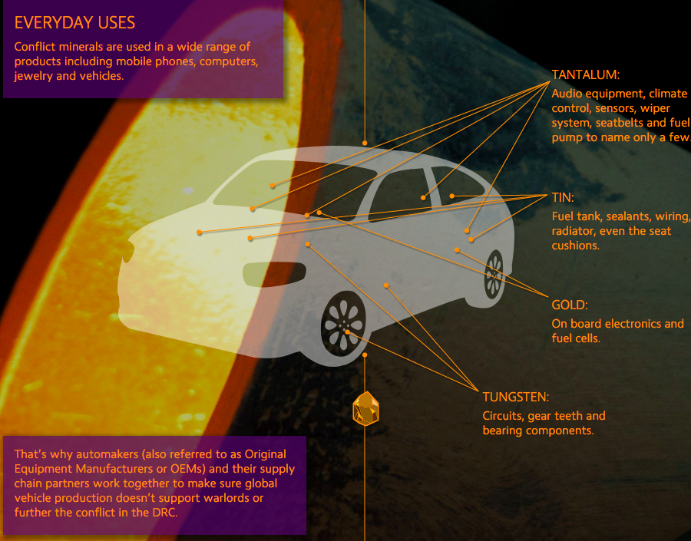
Storytelling of 3T’s in our Cars

Slide 35
Fair Food Program — the unfolding story of increasing compliance through the constant back and forth of audits, investigations, and corrections — over the course of all six seasons of the Program’s operation

Slide 36
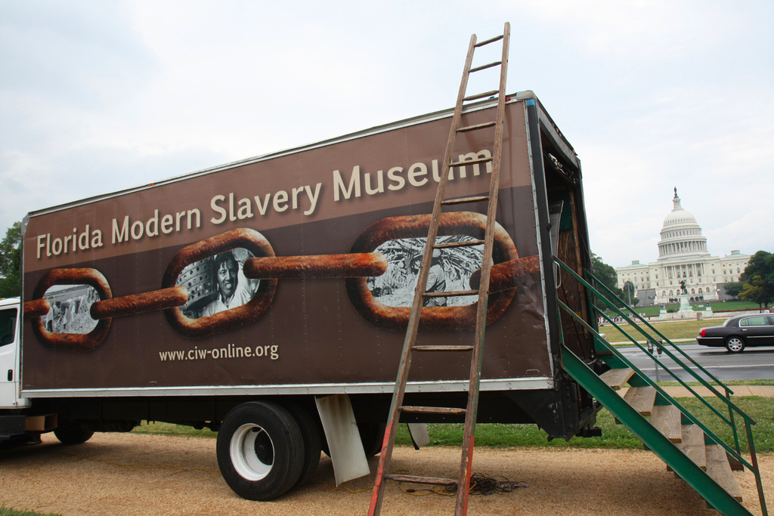
How can you help end global slavery supply chain?
Worker education,
Worker-driven alliances, &
System of alliance of consumers, brands, growers, and workers
This creates revolutionary changes

Slide 37
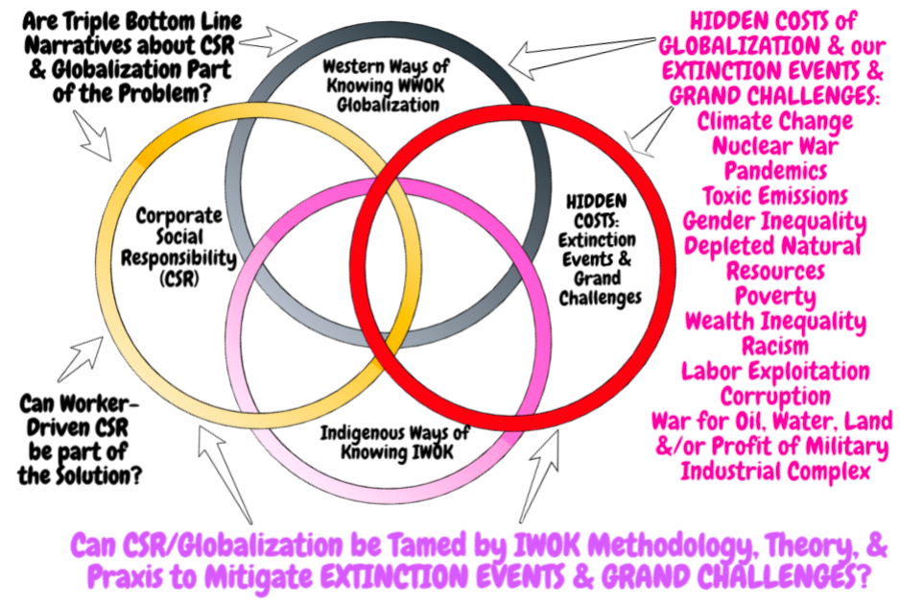

Slide 38
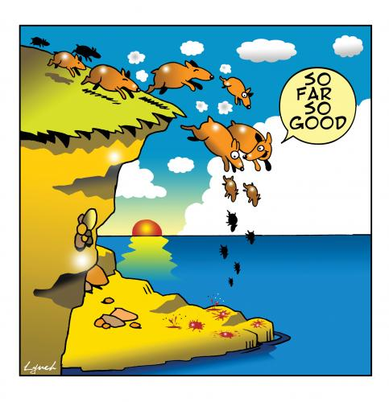
As we approach 6th Extinction

Slide 39
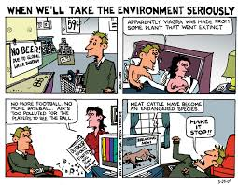
Pause for Q&A
Notes:
See Vinnarei & Laine (2017) The moral mechanism of counter accounts: The case of industrial animal production. Accounting Organizations and Society. Vol. 57: 1-17.

Slide 40
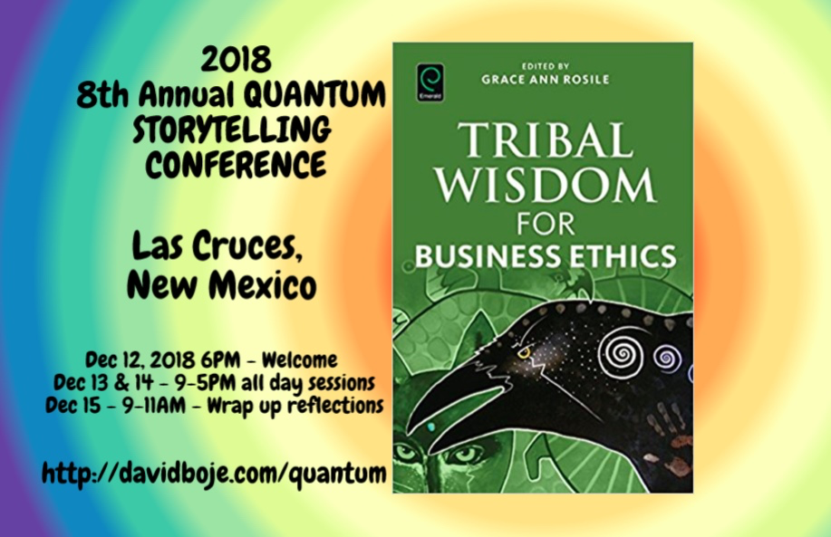
THANK YOU
Question & Answers about STORYTELLING
Slides & books at http://davidboje.com/Paris

